Slide 1
Stock Market Prediction Using
LSTM
Presented by-
Harshit Garg (I-18/ 181500254)
Hardik Gupta (I-15/ 181500244)
Subhi Varshney (H-59/ 181500730)
Kashish Chaudhary (I-21/ 181500316

Slide 2
Introduction
Predicting how the stock market will performs is one of the most difficult things to do.
There are numerous causes for this, including market volatility and a variety of other dependent and independent variables that influence the value of a certain stock in the market.
These variables make it extremely difficult for any stock market expert to anticipate the rise and fall of the market with great precision.
All these aspects combine to make share prices volatile and very difficult to predict with high degree of accuracy.

Slide 3
Literature Survey
The primary goal of our literature analysis was to assess various algorithms and models to see if stock price forecasts could be made based on actual stock prices.
We proceeded to review existing plans, analyse major difficulties, and better ourselves because we were unable to detect a possible change in this stock price estimate.
We identified LSTM after conducting a quick search for popular solutions to these problems.

Slide 4
Proposed Model
We propose to use the LSTM (Long Short Term Memory) technique to give effective stock price prediction and to evaluate how well our model has been trained by considering various aspects such as epochs and data size.

Slide 5
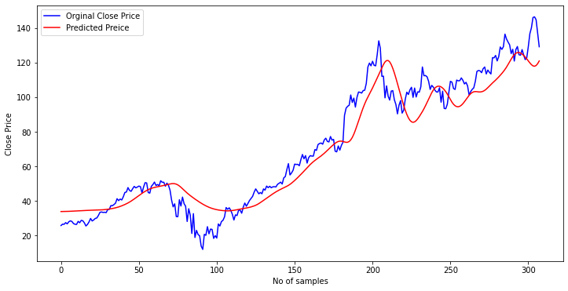
GUIs of Project
Dataset size – 1025
Dataset size - 1025
Epochs - 25

Slide 6
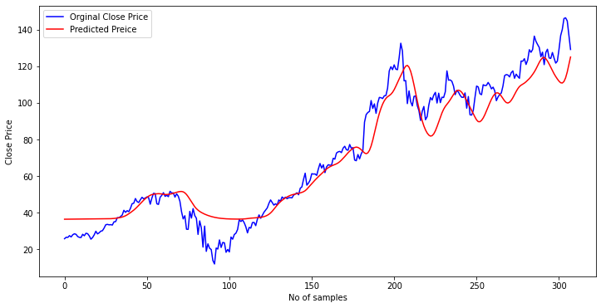
GUIs of Project
Dataset size - 1025
Epochs – 50

Slide 7
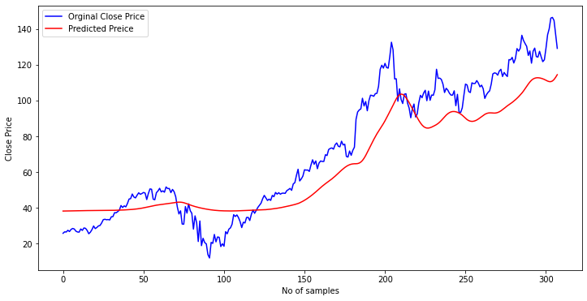
GUIs of Project
Dataset size - 1025
Epochs – 100

Slide 8
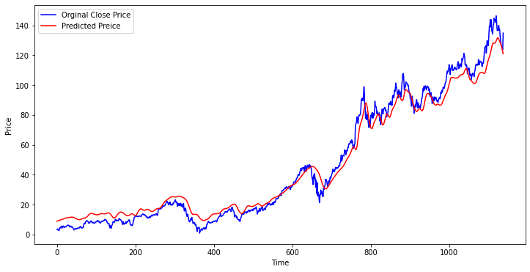
GUIs of Project
Dataset Size - 3795
Dataset size - 3795
Epochs – 25

Slide 9
GUIs of Project
Dataset Size - 3795
Dataset size - 3795
Epochs – 50

Slide 10
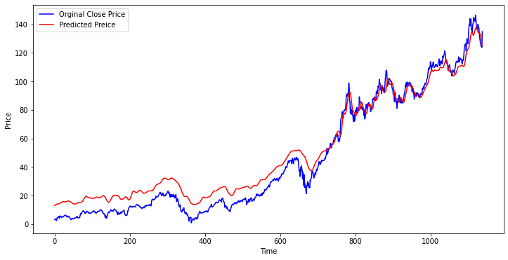
GUIs of Project
Dataset Size - 3795
Dataset size - 3795
Epochs – 100

Slide 11
Result Analysis
Dataset size - 1025
 | 25 Epochs | 50 Epochs | 100 Epochs
Mean Absolute Error | 8.5813 | 7.655 | 13.186
Mean Squared Error | 112.680 | 102.796 | 245.170
Root Mean Square Error | 10.615 | 10.138 | 15.657
R2 Score | 0.916 | 0.923 | 0.818

Slide 12
Dataset size - 3795
 | 25 Epochs | 50 Epochs | 100 Epochs
Mean Absolute Error | 7.261 | 5.213 | 7.42
Mean Squared Error | 66.310 | 40.160 | 70.10
Root Mean Square Error | 8.143 | 6.33 | 8.37
R2 Score | 0.96 | 0.976 | 0.95

Slide 13
Conclusion
Many investors all over the world are interested in stock investing. Making a decision, on the other hand, is a difficult task due to the numerous factors involved. Investors are eager to forecast the stock market's future after making successful investments. Even a small improvement in performance can have a huge impact. By providing supporting information such as future stock price guidance, a good forecasting system can assist investors in making more accurate and profitable investments.

Slide 14
This paper proposes the LSTM model for forecasting stock values. We can now say that if we take a large data set and train the LSTM model for 50 epochs, we will get highly accurate predicted data.
Our model's output has yielded some promising results. The results of the tests show that our model can track the evolution of closing prices.
We will try to find a method to forecast future data with the same accuracy in our future work, as well as develop a mobile application that shows all of the forecasting.

